Slide 1
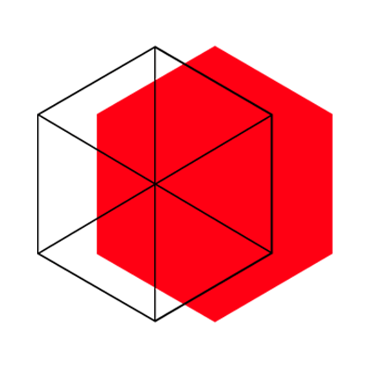
XinFab: Creating an Environment for Designers

Slide 2

A FabLab comes up

Slide 3
What is a FabLab?
The educational outreach component of MIT’s Center for Bits and Atoms, based on professor Neil Gershenfeld’s course “How to make (almost) everything”.
A part of maker culture where ordinary people are empowered to learn, play, create, design, build, innovate, and invent on their own or with other makers.
What’s it good for? “Not to make what you can buy in stores, but to make what you can't buy in stores. It's to personalised fabrication.”

Slide 4
XinFab is creating an environment for you.

Slide 5
What is XinFab?
A fablab located in the heart of Shanghai.
A non profit organization that supports and encourages everyone to create things.
A technical prototyping platform offers hackers, makers, creatives and designers the space and tools to digitally fabricate objects, from furniture to jewelry, robots to food.

Slide 6
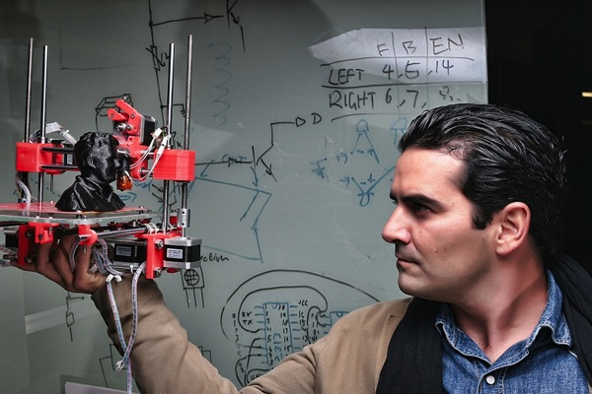
Who found XinFab?
Lucio
Moved from Brazil to Shanghai 4 years ago.
The founder and soul of Xinfab.
Also an allround maker, but specialised in 3d printers.

Slide 7
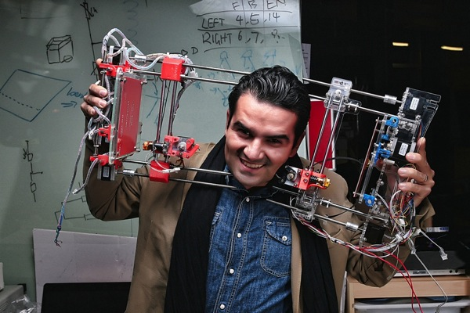
Who found XinFab?

Slide 8
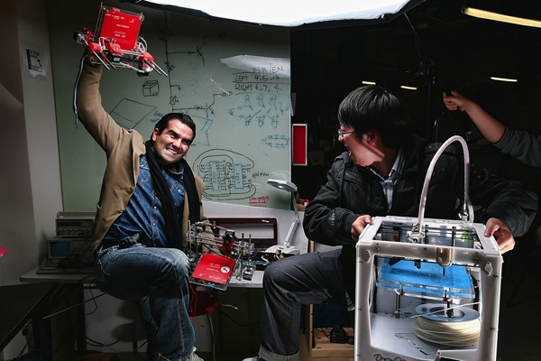
Who found XinFab?

Slide 9
What does XinFab offer?
Equipments
Services
Challenges

Slide 10
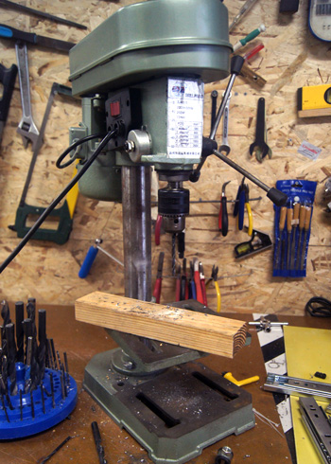
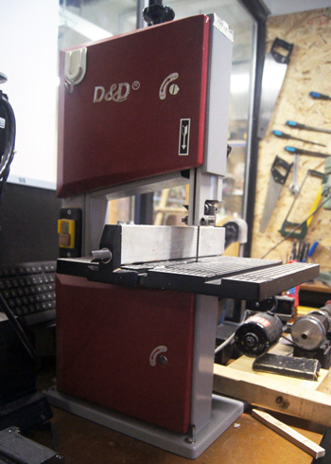
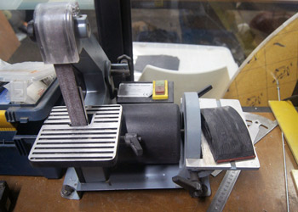
Equipments
Pillar Drill
Band Saw
Sanding Machine

Slide 11
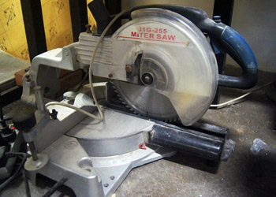
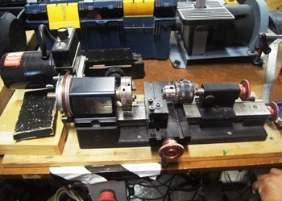
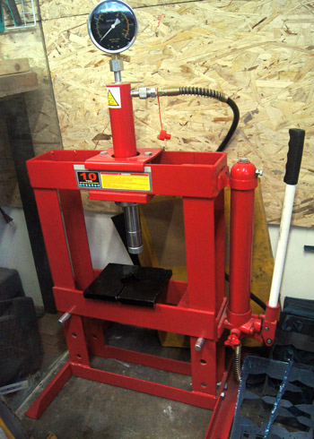
Equipments
Miter Saw
Lathe
Hydraulic Press

Slide 12
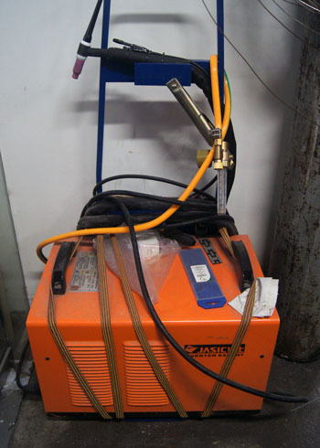
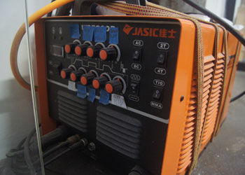
Equipments – Welding Machine

Slide 13
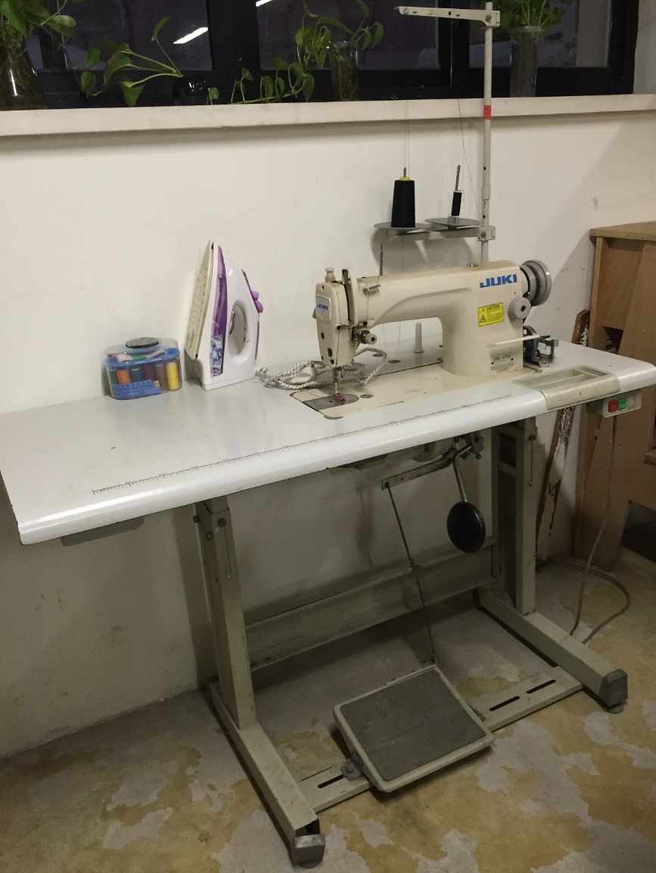
Equipments – Sewing Machine

Slide 14
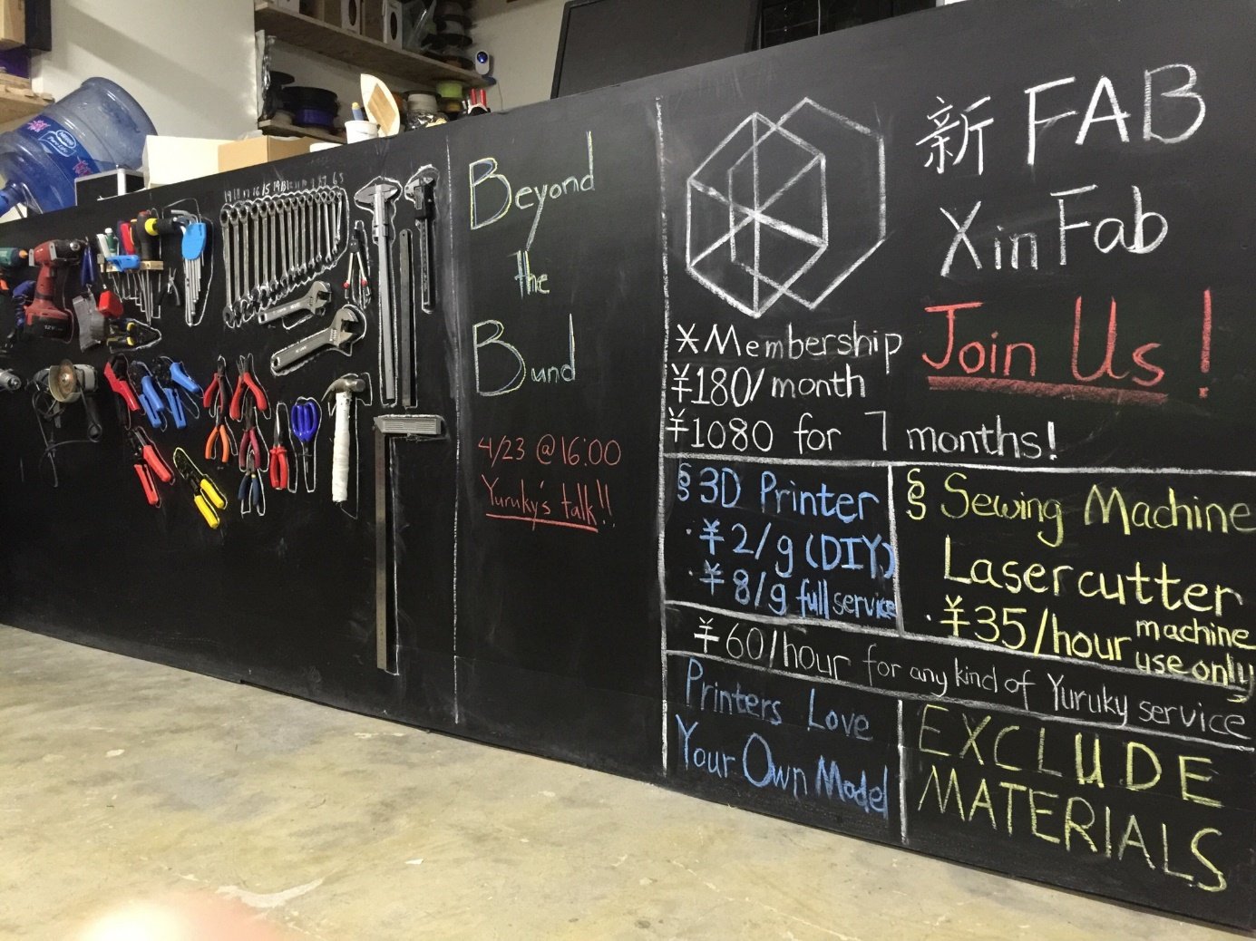
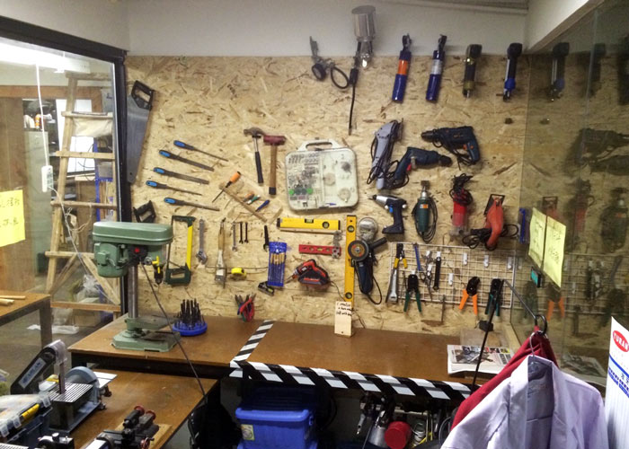
Equipments – Small Machinery

Slide 15
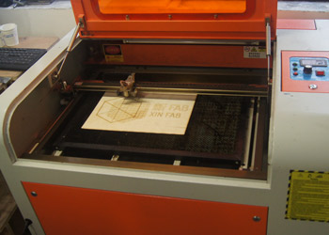
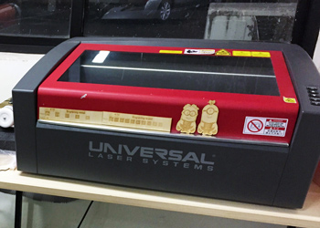
Equipments – Lasercutters
For: Wood / Carbon Fiber/ Acrylic / Fabric / Leather

Slide 16
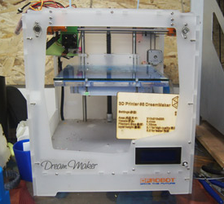
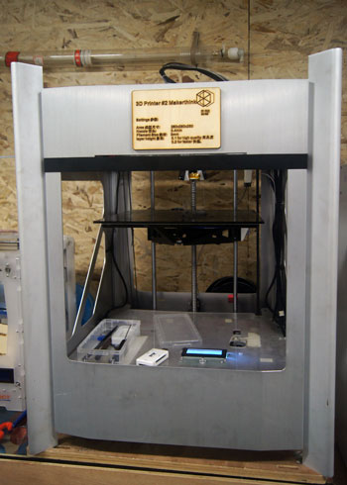
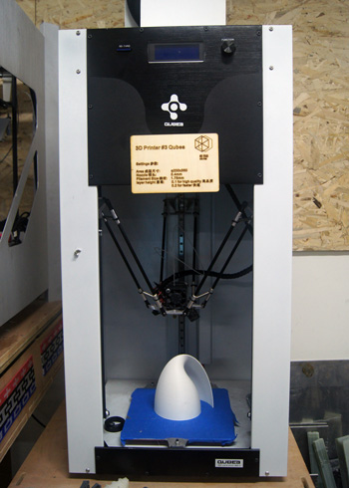
Equipments – 3D Printers
Dream Maker
Maker Think
Qubea

Slide 17
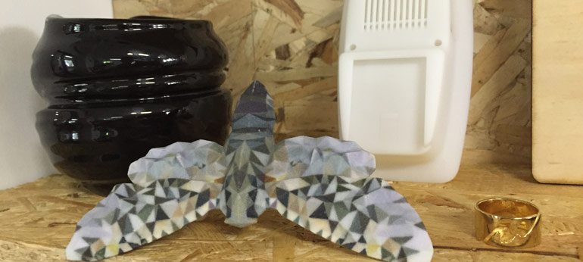
Equipments – 3D Printing Materials
PLA
ABS
Nylon
Resin
Aluminium
Gold
Silver
Ceramics

Slide 18
Services
Individuals
For individuals we offer our space and machines to work on private or commercial projects.
Also individuals can sign up for workshops to learn more about the machines that we have or just for fun!

Slide 19
Services
Business
From startups to non profit organizations to big commercial companies we offer services like - product design, - production of prototypes, - 3d printer maintenance, - workshops for learning and team building purposes.

Slide 20
Services
Education
For educational partnership we offer workshops, varying from half day workshops to long term workshops, with the focus on educating students about
- creative - technology - design thinking - production methods
(digital fabrication based on 3D printers, Lasercutters and CNC)

Slide 21
Services
Workshops
We organize workshop by interests of the public.
Software: - Photoshop / Illustrator / Corel Draw - Sketchup / Fusion 360 / Solidworks
Machines: Lasercutters 3D Printers Sewing Machine Small Machinery

Slide 22
What can you do here?

Slide 23
{ }
Hack
Make
Create
Design

Slide 24
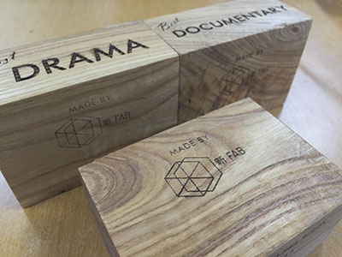
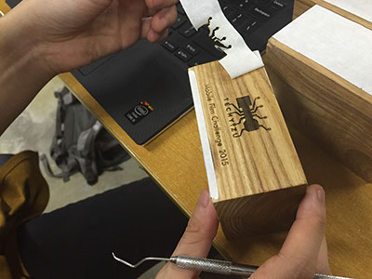
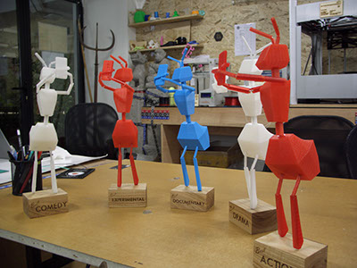
What has been done at XinFab?
Techyizu Mobile Film Challenge Award

Slide 25
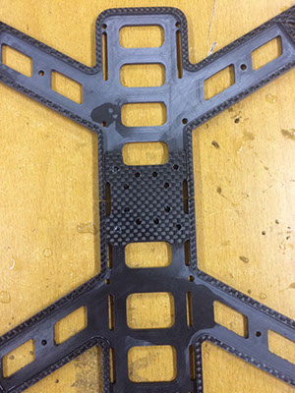
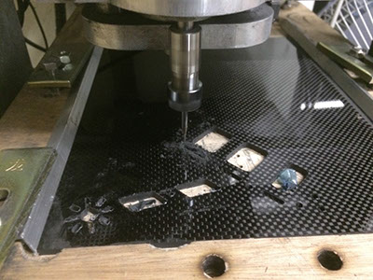
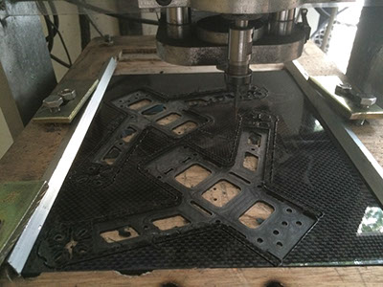
What have been done at XinFab?
Carbon Racing Drone

Slide 26
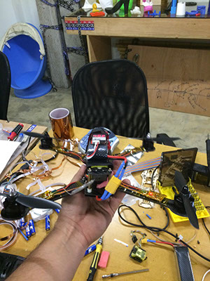
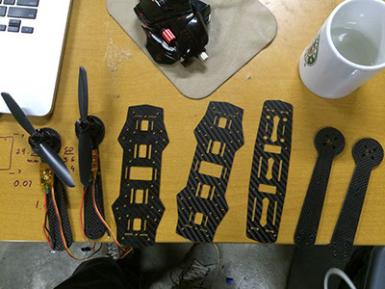
What have been done at XinFab?
Carbon Racing Drone

Slide 27
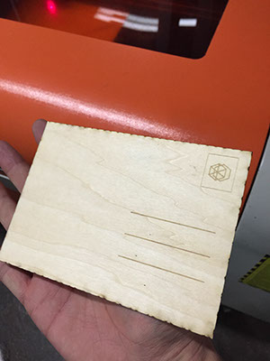
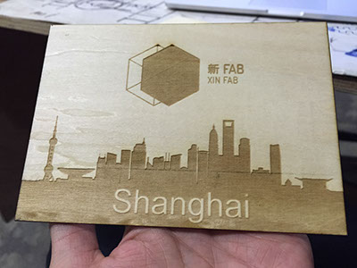
What have been done at XinFab?
Lasercut Postcard

Slide 28
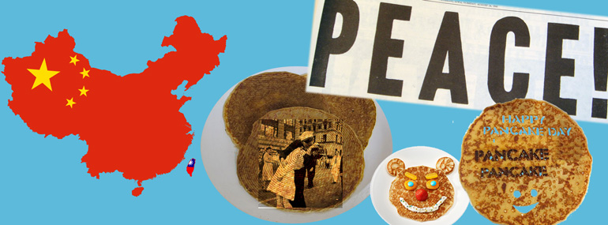
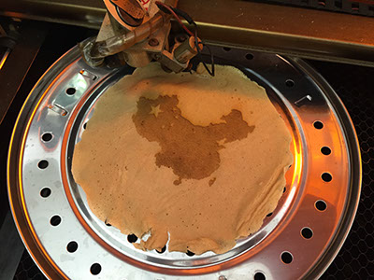
What have been done at XinFab?
Lasercut Pancakes

Slide 29
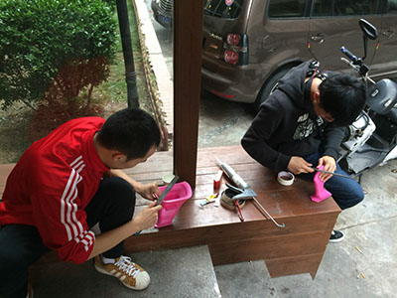
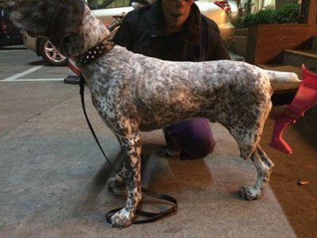
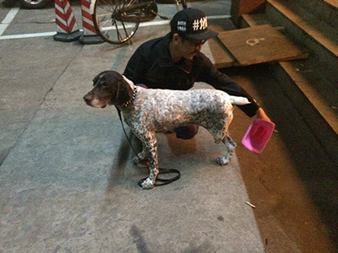
What have been done at XinFab?
Dog Prosthetic

Slide 30
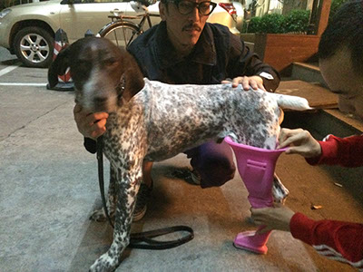
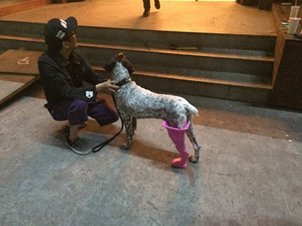
What have been done at XinFab?
Dog Prosthetic

Slide 31
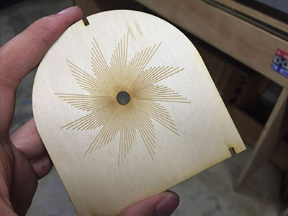
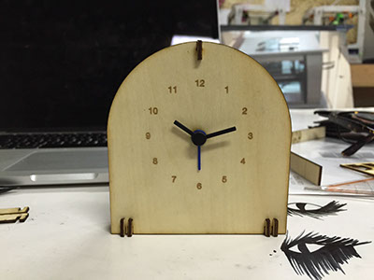
What have been done at XinFab?
Lasercut Clocks

Slide 32
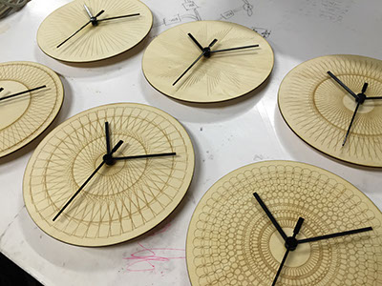
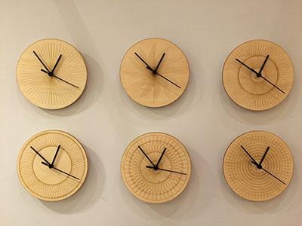
What have been done at XinFab?
Lasercut Clocks

Slide 33
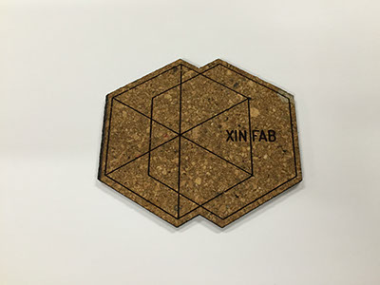
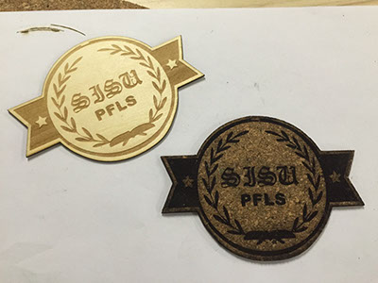
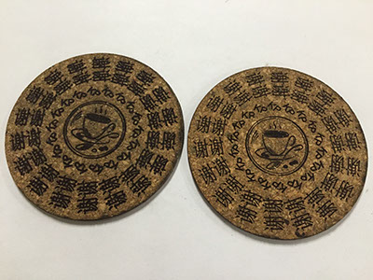
What have been done at XinFab?
Coasters

Slide 34
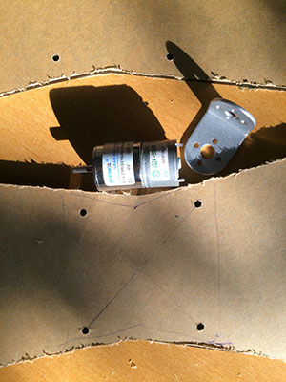
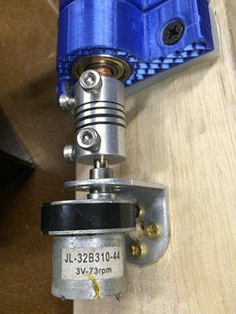
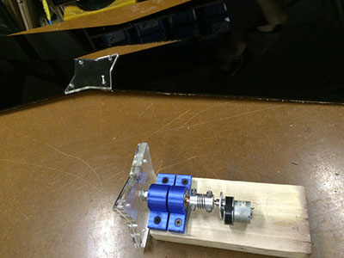
What have been done at XinFab?
Big Propellor for Short Movie

Slide 35
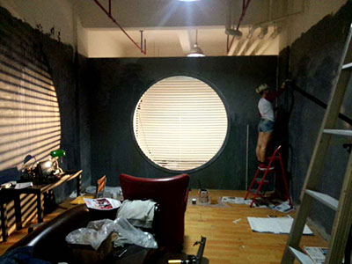
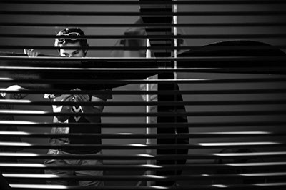
What have been done at XinFab?
Big Propellor for Short Movie

Slide 36


What have been done at XinFab?
Big Propellor for Short Movie

Slide 37


What have been done at XinFab?
Big Propellor for Short Movie
In a room where time doesn't exist.
3 Men are lost in quest of writing loop story

Slide 38




What have been done at XinFab?
Logo Engraving Ironman

Slide 39

What have been done at XinFab?
Lasercut Leather Cases

Slide 40



What have been done at XinFab?
Other Lasercut Products

Slide 41


What have been done at XinFab?
Other Lasercut Products

Slide 42


What have been done at XinFab?
Other Lasercut Products

Slide 43

What have been done at XinFab?
Bamboo Workshop - Educational

Slide 44

What have been done at XinFab?
Portable 3D Printer by Lucio

Slide 45
Challenged?

Slide 46
Who made them?

Slide 47
{ }
Hackers
Makers
Creatives
Designers

Slide 48
Creating an Environment for Designers
Resident Program
We welcome everyone, who loves design/making things.
You can work at XinFab, using the tools and machines freely.
But you will spend 20% time to contribute to this space
Or organize workshops at least once a month
We will showcase your works at XinFab and promote you.

Slide 49

Creating an Environment for Designers
Danny Kuo
(The Netherlands)
Product/Interior Designer
The First Resident in XinFab
He created the new interior to help organize the space better.
And works at XinFab at a daily basis to help people who love design and need to use this space.

Slide 50



Products of Danny, XinFab’s Resident Designer
Liberty Lamp

Slide 51






Products of Danny, XinFab’s Resident Designer
Double
Table

Slide 52


Products of Danny, XinFab’s Resident Designer
Bamboo Pyramid
In collaboration with Matzform / HHD in Shanghai we have designed the Bamboo Pyramid. It's an object which will showcase the qualities of bamboo, as sheet material as well as a plant. The Bamboo Pyramid will be exhibited in several different places in Denmark.

Slide 53


Products of Danny, XinFab’s Resident Designer
Staircase
The shelving unit is 2.6 meters high and the top shelves are accessible by using the bottom shelves as steps for accessing the higher shelves.

Slide 54


Danny created new interior for XinFab
Interior Change / Pipe Shelving

Slide 55


Danny created new interior for XinFab
Interior Change / Pipe Shelving

Slide 56
He can make quick prototype of his work here,
Based on digital fabrication.

Slide 57



A small model for his client

Slide 58
Also he shares knowledge

Slide 59

Design at XinFab - Sketch

Slide 60

Design at XinFab - Sketch

Slide 61

Design at XinFab - Sketch

Slide 62



Design at XinFab - Sketch

Slide 63

Design at XinFab - Sketch

Slide 64



Design at XinFab – Build 3D Model

Slide 65




Design at XinFab – Print 3D Model

Slide 66

Design at XinFab – Lasercut 3D Model

Slide 67

Design at XinFab – In Progress

Slide 68


Design at XinFab – In Progress

Slide 69


Design at XinFab – High Finishing from Factory

Slide 70


Design at XinFab – High Finishing from Factory

Slide 71


Design at XinFab – High Finishing from Factory

Slide 72


Design at XinFab – High Finishing from Factory

Slide 73
Wait, Yuruky needs a table to put
his iPad and iPhone in

Slide 74

Yuruky’s Biang Biang Table

Slide 75

Yuruky’s Biang Biang Table

Slide 76

Yuruky’s Biang Biang Table

Slide 77

Yuruky’s Biang Biang Table – Cat Castle

Slide 78



Yuruky’s Biang Biang Table – Cat Castle

Slide 79
Design
Make a Plan
Do It In a Professional Way
Re-Design

Slide 80
Quick Prototyping × Digital Fabrication
Sketch → Digital Model → Send the file to the machine → Fabricate
Not satisfied with the physical prototype? → Revise the digital model → Send the file to the machine → Fabricate
Still not satisfied? Run b) again.

Slide 81
Still not satisfied?
Want much quicker?

Slide 82
Creating an Environment for Designers
Designers Community based on XinFab
We want to gather people together, who is new, interested in and familiar with digital fabrication and design thinking.
Question: I need a 3D model and print it, can you teach me / do it for me / tell me how and where I can make it myself?
XinFab will help you.
This community will help you.
Workshops, exhibitions, talks and events

Slide 83
Designers Community based on XinFab
Hey guys, this weekend I’m going to XinFab make a separated hover board, come to join!
Er… I have a problem to make it lighter, which part should I reduce the weight? Does anyone know how to do it?
Now I know how and I want to design it myself, but I have no idea about 3D modeling. Can somebody hold a workshop?
Oh great, my first prototype is working and I’ll put one at XinFab, you guys just try it out and give me feedbacks please.
God, I love to design and make things. Well done, man!!

Slide 84
Designers Community based on XinFab
I want a SLA printer which is more precise and high finishing, is anybody interested in buy it together and share?
Well, I think the furniture in XinFab now is not so cosy and I’m gonna re-design it.
Look, we need more hand tools for woodworking and I’ll get some here.
Man, some of these machines are too old. Let’s figure out how we can find new ones because I can’t do it myself and I think people really need them functioning well.

Slide 85

Designers Community based on XinFab
Please scan & join this community.
We can discuss with, learn from and give a hand to each other.

Slide 86
We’re creating
An environment for
Ourselves together!!

Slide 87
Creating an Environment for Designers
Products
XinFab
Designers
Environment

Slide 88
Creating an Environment for Designers
Not just behind your laptop screen,
but in front of the materials, machines and your physical prototype.
The machine is not a solid thing, it could be re-designed.
The material is not a solid thing, it could be re-designed.
The environment is not a solid thing, it could be re-designed.
Your product is not a solid thing, it could be re-designed.
You are not a solid thing, you could be re-designed.
Design through quick prototyping,
gradually you will get to sense the world as a whole.

Slide 89
"Common sense is instinct,
and enough of it is genius."
—— Josh Billings (1818-1885)

Slide 90
“Sorry man, you talk too much.
Gotta go to XinFab, let’s be quick!”

Slide 91

Where are we?
上海市， 静安区， 愚园东路 28 号 3 号楼 1楼 Yu Yuan east road 28, building 3, first floor Crossing of YuYuan Dong Lu & ChangDe Lu. Jingan district,
Shanghai

Slide 92

Entrance

Slide 93

Cafeteria

Slide 94

Meeting Room

Slide 95


Welcome to XinFab

Slide 96


Welcome to XinFab

Slide 97


Welcome to XinFab

Slide 98


Welcome to XinFab

Slide 99









Sponsorship

Slide 100
Welcome to XinFab
Join our community
Get your work done
And have fun!!

Slide 101
XinFab: Creating an Environment for Designers

